Slide 1
Serpent’s Survival
By; Aaron & Om

Slide 2
What is it?
A video game using C# about snakes. It will be a complex game full of many mechanics. It will implement the lessons learned from last years program and more.

Slide 3
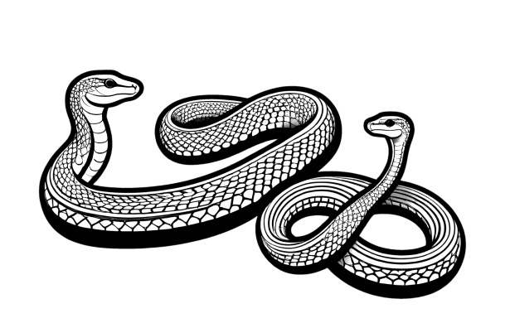
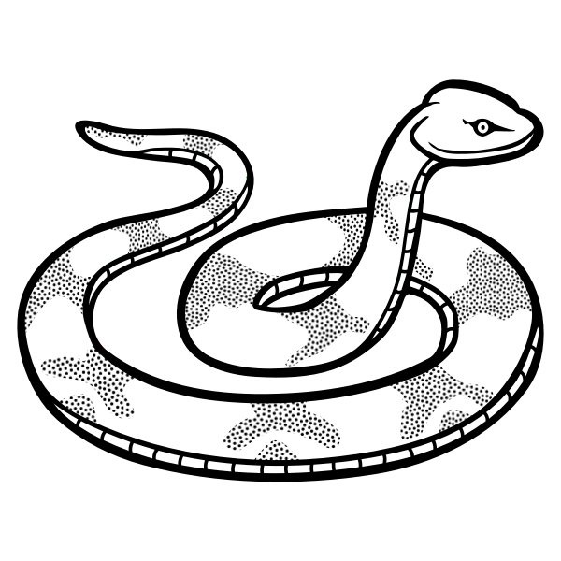
Why Serpent’s Survival?
Om and I choose to do this because we love creating games and he loves snakes. During our last year at DAE we learned how to create 2D and 3D games respectively. By combining our skills we will be able to work twice as fast and create a more complex product.

Slide 4
Why it matters?
It matters because creating games is our passion. We want people to enjoy the games we create and to enjoy the story we (mostly Om) have to tell. We want the game to help people stay entertained. It is the dream of a game developer for their game to entertain people.

